Slide 1

FE-545

Slide 2
Implied Volatility and Vega
FE-545
Lecture 2
Ricardo A. Collado Assistant Professor School of Business

Slide 3
Introduction
It is traditional to quote prices in terms of the Black–Scholes implied volatility
The implied volatility is by definition the number to plug into the Black–Scholes formula to get the price desired
Thus we have the problem that we must solve the problem of finding the value σ such that BS(S, K, r, d, T, σ) = quoted price

Slide 4
Introduction (cont’d)
This is a typical problem in Analysis
For a continuous function f and given y, find x such that f(x) = y
Instead we look for roots of the function g(x) = f(x) – y

Slide 5
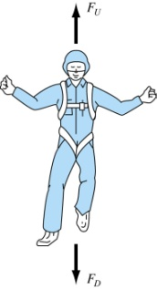
Introduction (cont’d)
General example:
What is the ground velocity ?
t=0, v = 0;
1 km
We know the velocity:

Slide 6
Introduction (cont’d)
from
Find the distant
hence
Find t_{1km} that s = 1000 m from

Slide 7
Introduction (cont’d)
So solve t_{1km} from
Can we solve the above equation for t_{1km}?
Not trivial since the equation is nonlinear and t_{1km} is an implicit variable

Slide 8
Introduction (cont’d)
Solving a simple quadratic equation, is easy:
But what about these
This shows the need for numerical methods!

Slide 9
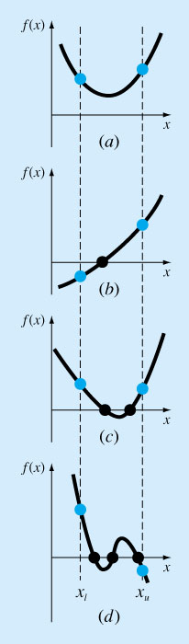
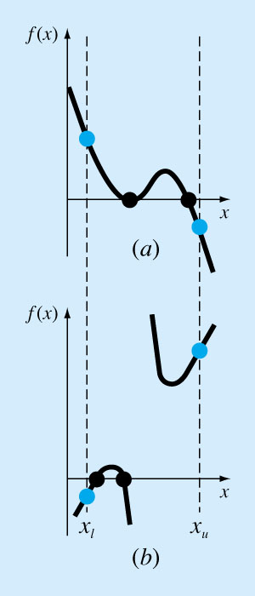
Bisection

Slide 10
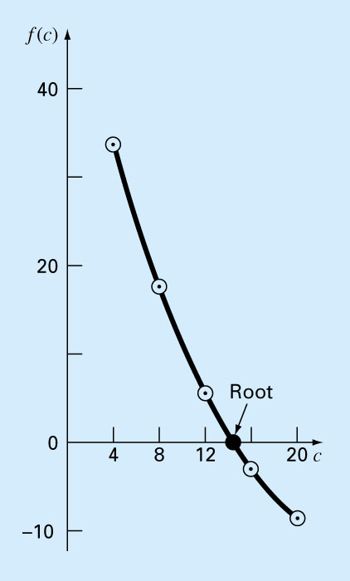
Bracketing…
Sometimes called two-point method
Underling principle:
Root of f (x) is bounded by
{x_{L}, x_{U}} where
f(x_{L}) f(x_{U}) < 0

Slide 11
Bisection (cont’d)
How many iterations will it take?
Length of the first Interval Δx⁰ = b-a
After 1 iteration ε_{a}(1) = Δx⁰/2
After 2 iterations ε_{a}(2) = Δx⁰/4
After k iterations ε_{a}(n) = Δx⁰/2^{n}

Slide 12
Bracketing:Bisection
For the arbitrary equation of one variable, f(x)=0
Pick x_{l} and x_{u} such that they bound the root of interest, check if f(x_{l}).f(x_{u}) <0.
Estimate the root by evaluating f[(x_{l}+x_{u})/2].
Find the pair
If f(x_{l}). f[(x_{l}+x_{u})/2]<0, root lies in the lower interval, then x_{u}=(x_{l}+x_{u})/2 and go to step 2.

Slide 13
Bisection (cont’d)
If f(x_{l}). f[(x_{l}+x_{u})/2]>0, root lies in the upper interval, then x_{l}= [(x_{l}+x_{u})/2, go to step 2.
If f(x_{l}). f[(x_{l}+x_{u})/2]=0, then root is (x_{l}+x_{u})/2 and terminate.
Compare ε_{s} with ε_{a}
If ε_{a}< ε_{s,} stop. Otherwise repeat the process.

Slide 14
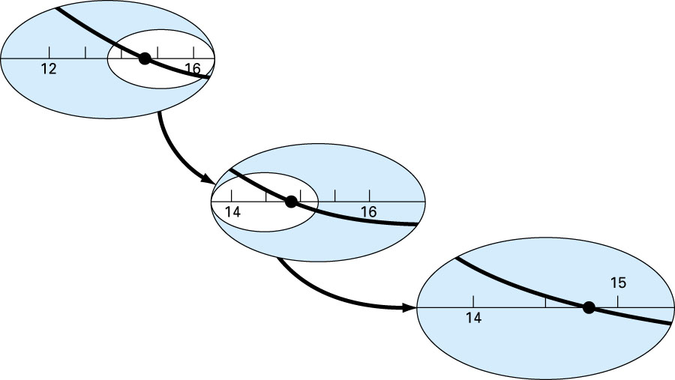
Bisection (cont’d)

Slide 15
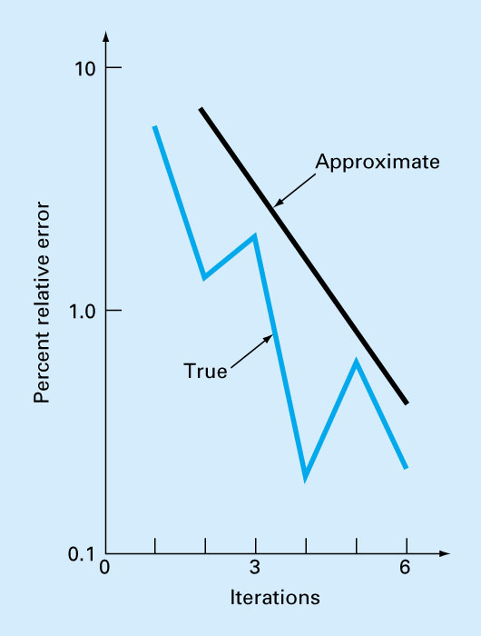
Bisection (cont’d)

Slide 16
Bisection (cont’d)
Evaluation of Method
Pros
Easy
Always find root
Number of iterations required to attain an absolute error can be computed a priori.
Cons
Slow
Know a and b that bound root
Multiple roots
No account is taken of f(x_{l}) and f(x_{u}), if f(x_{l}) is closer to zero, it is likely that root is closer to x_{l} .

Slide 17
Bisection (cont’d)
If the absolute magnitude of the error ε_{s} = 1e-4
and L_{o}=2, how many iterations will you have to do to get the required accuracy in the solution?

Slide 18
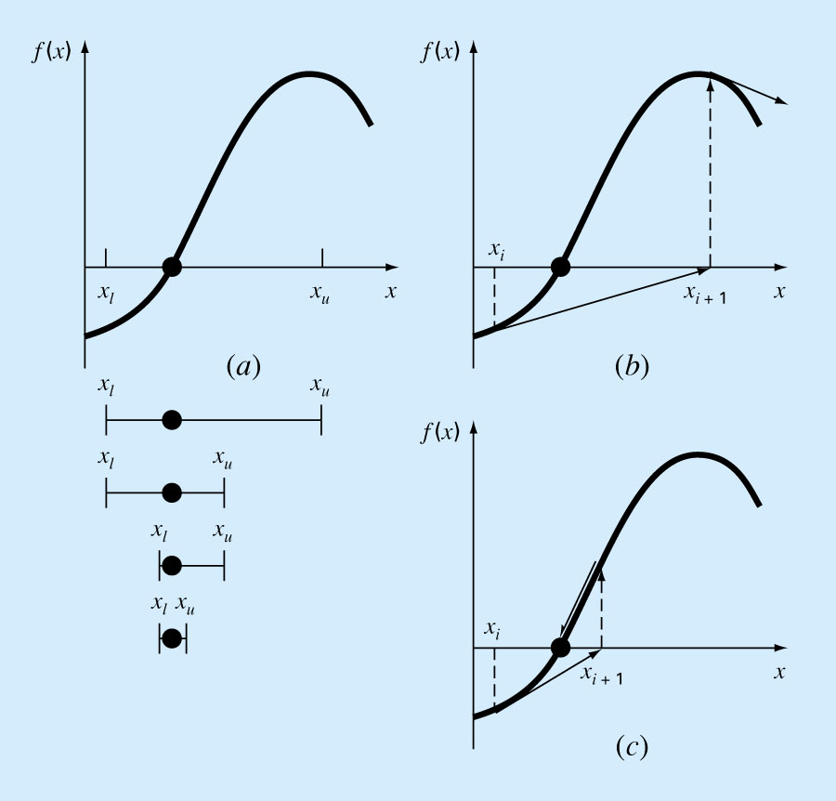
Open methods
Open methods are based on formulas that require only a single starting value of x or two starting values that do not necessarily bracket the root.

Slide 19
Fixed-point…(cont’d)
Rearrange the function so that x is on the left side of the equation:
Bracketing methods are “convergent”.
Fixed-point methods may sometime “diverge”, depending on the stating point (initial guess) and how the function behaves.

Slide 20
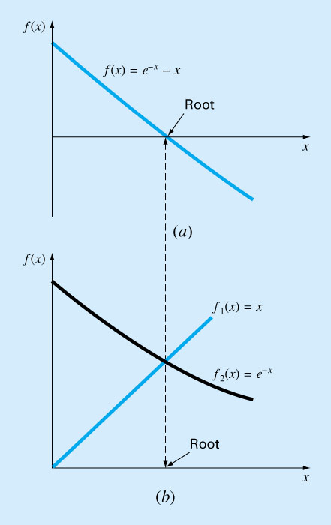
Fixed-point…(cont’d)
Convergence
x=g(x) can be expressed as a pair of equations:
y₁=x
y₂=g(x) (component equations)
Plot them separately.

Slide 21
Fixed-point…(cont’d)
Fixed-point iteration converges if
When the method converges, the error is roughly proportional to or less than the error of the previous step, therefore it is called “linearly convergent.”

Slide 22
Fixed-point…(cont’d)
Example
Rearrange x = g(x)

Slide 23
Newton-Raphson
Most widely used method.
Based on Taylor series expansion:
Solve for
Newton-Raphson formula

Slide 24
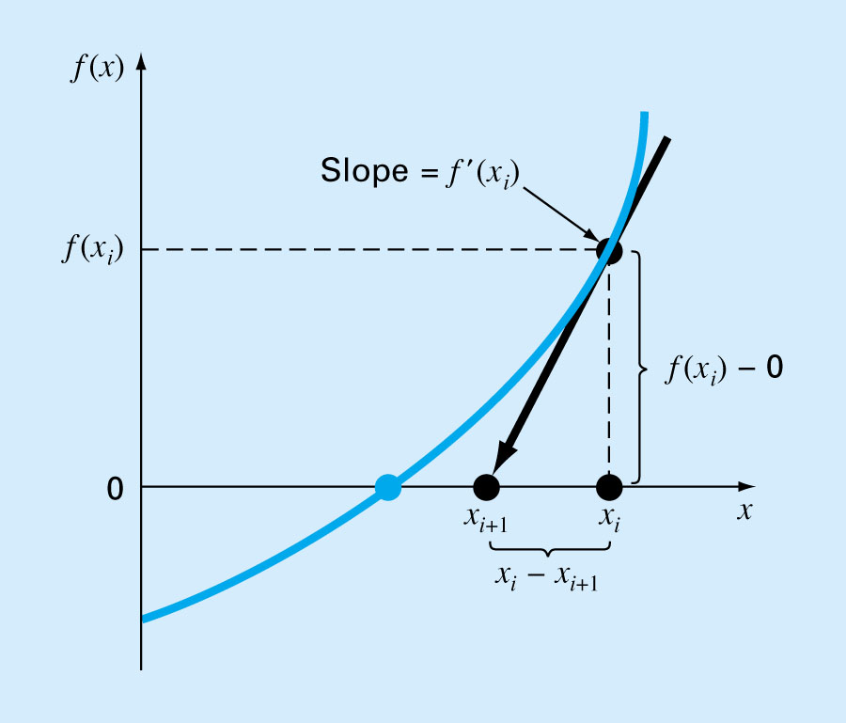
Newton-Raphson… (cont’d)
A convenient method for functions whose derivatives can be evaluated analytically. It may not be convenient for functions whose derivatives cannot be evaluated analytically.

Slide 25
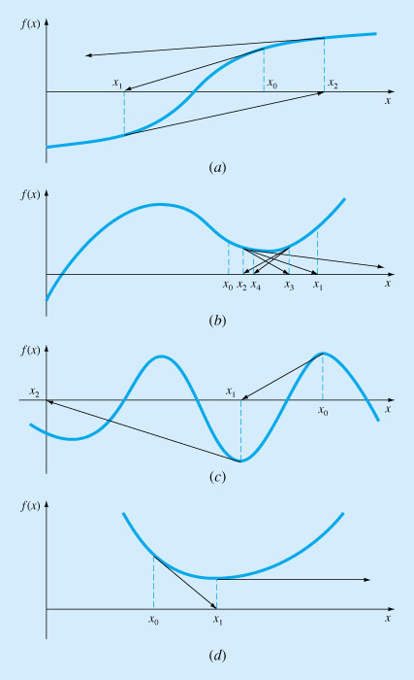
Newton-Raphson… (cont’d)

Slide 26
Secant method
A slight variation of Newton’s method for functions whose derivatives are difficult to evaluate. For these cases the derivative can be approximated by a backward finite divided difference.

Slide 27
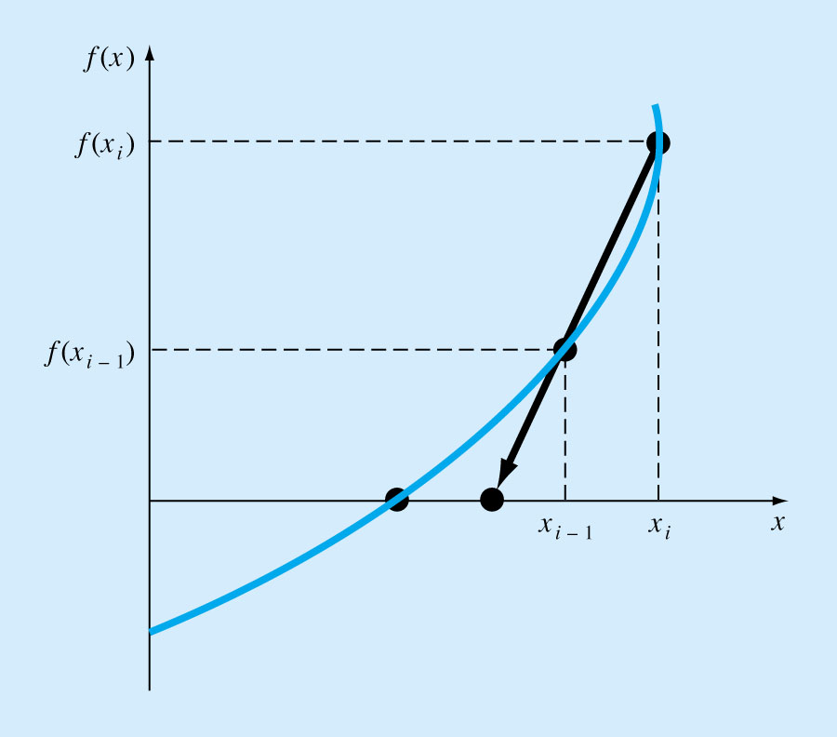
Secant method(cont’d)
Requires two initial estimates of x , e.g, x_{o}, x₁. However, because f(x) is not required to change signs between estimates, it is not classified as a “bracketing” method.
The scant method has the same properties as Newton’s method. Convergence is not guaranteed for all x_{o}, f(x).

Slide 28
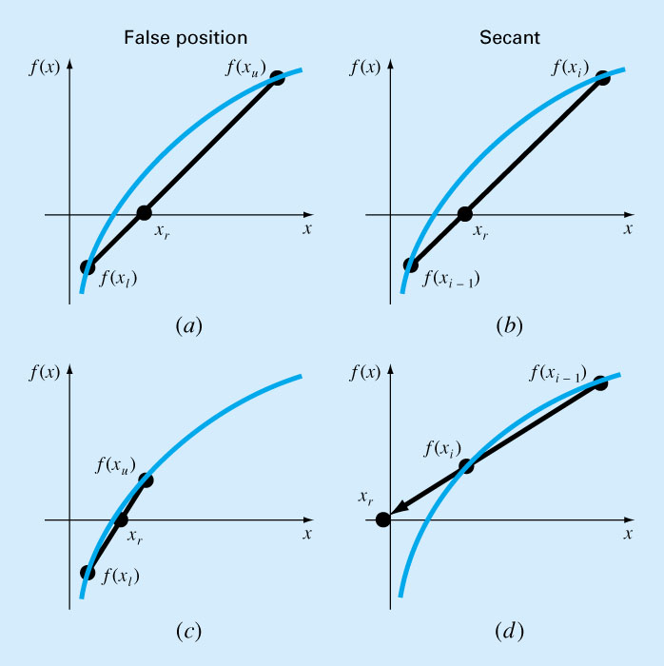
Secant method(cont’d)

Slide 29
The Vega
In our simulation we solve the problem of finding the value σ such that: BS(S, K, r, d, T, σ) = quoted price
To do this with the Newton-Raphson method we need the derivative of the option price with respect to the volatility
This is known as the Vega

Slide 30

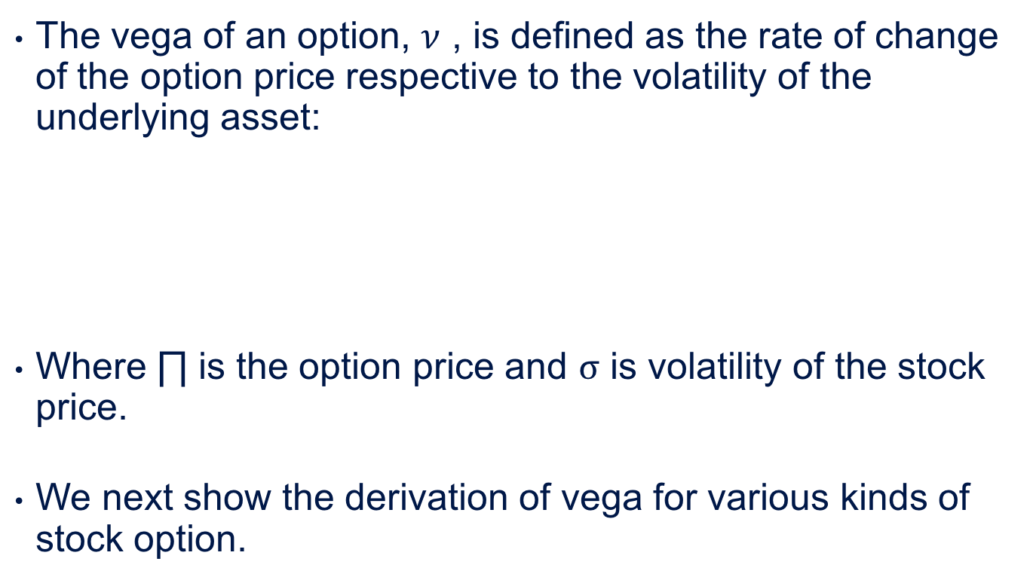

Slide 31
Derivation of Vega for Different Kinds of Stock Options
For a European call option on a non-dividend stock, vega can be shown as

Slide 32
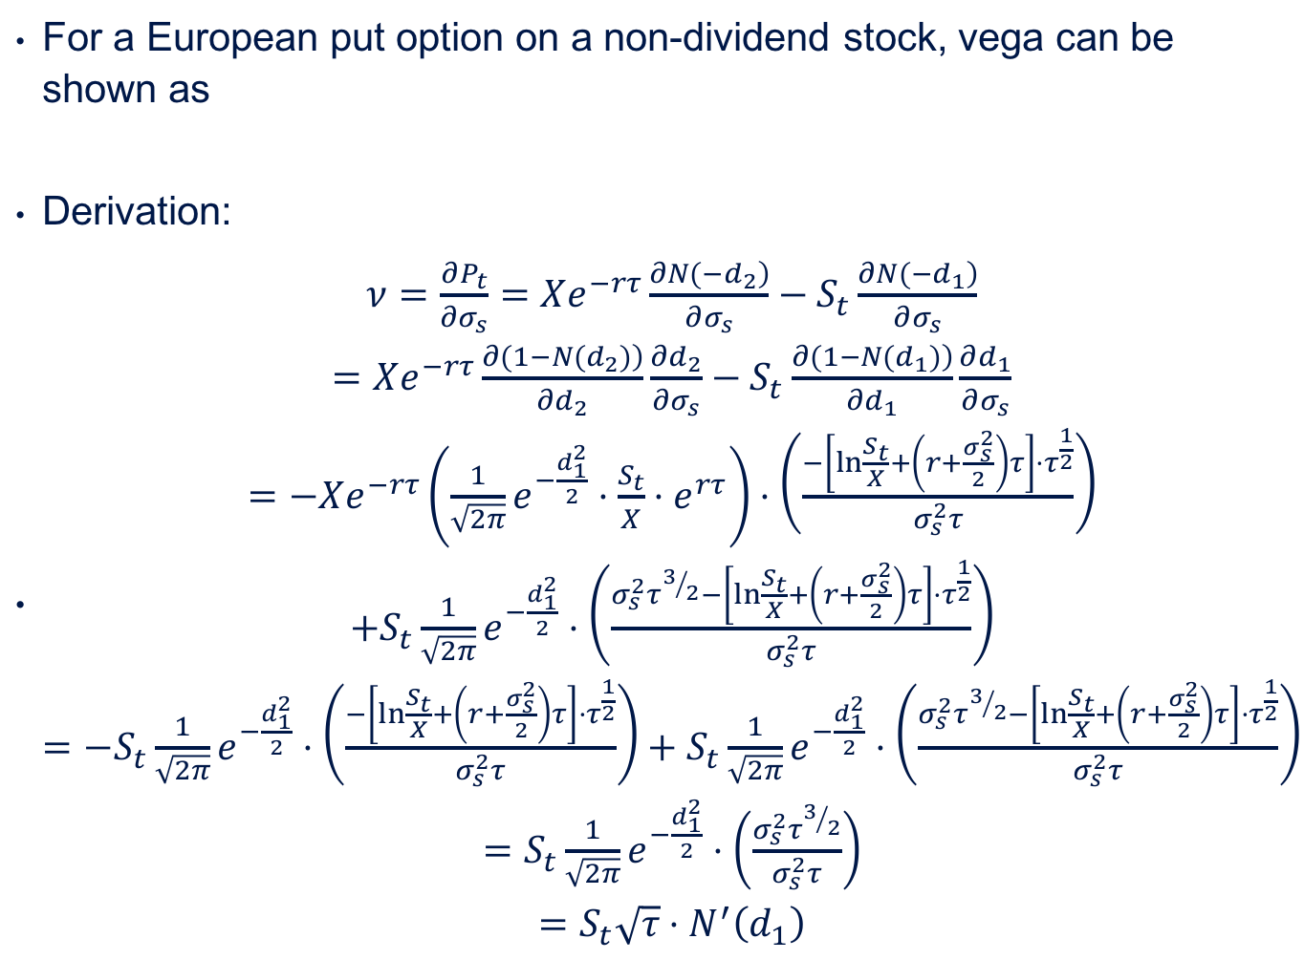

Slide 33
For a European call option on a dividend-paying stock, vega can be shown as
Derivation:

Slide 34
For a European call option on a dividend-paying stock, vega can be shown as
Derivation:

Slide 35

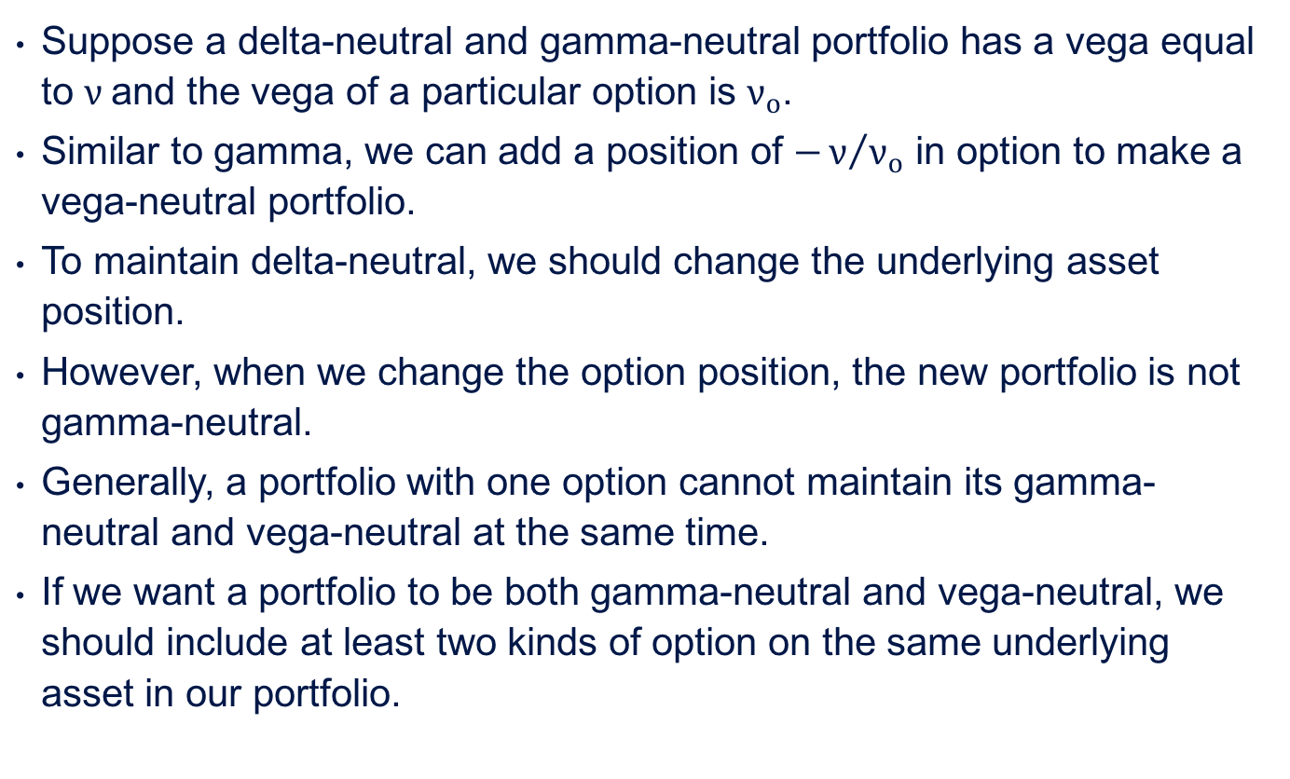

Slide 36
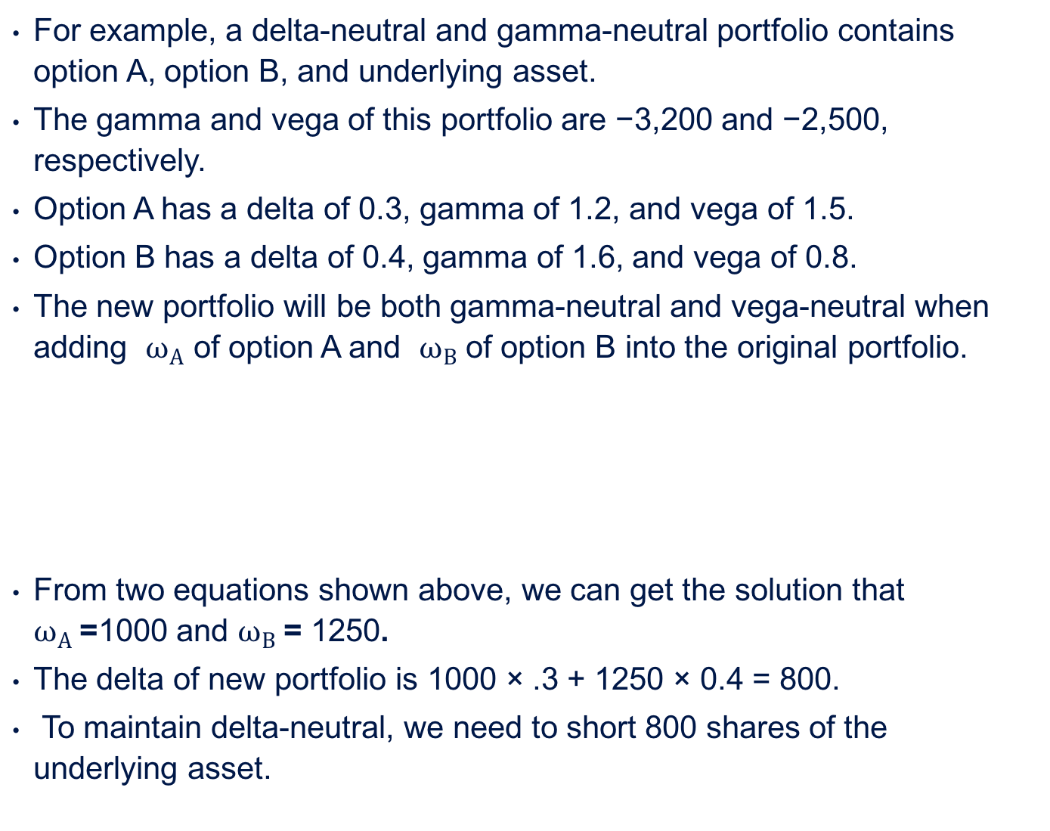

Slide 37
Ricardo A. Collado
rcollado@stevens.edu
(201) 216-8156

